Slide 1
ABSTRACT WRITING

Slide 2
Sample 1
This paper explores privacy issues in relation to the growing prominence of marketing research and data mining in websites for children. Whereas increasing protection is given to individuals’ personal information, little attention is paid to information that is aggregated, electronically scanned, and sorted — despite the fact that aggregate information is often highly valued by the marketing industry. The authors review current trends in Internet market research, data mining techniques, policy initiatives, and the contents of some of the most highly frequented children’s game sites. The paper demonstrates how common data mining practices constitute a threat to children’s emerging rights online.

Slide 3
Sample 2
Human-robot collaborative work has the potential to advance quality, efficiency and safety in manufacturing. In this paper we present a gestural communication lexicon for human-robot collaboration in industrial assembly tasks and establish methodology for producing such a lexicon. Our user experiments are grounded in a study of industry needs, providing potential real-world applicability to our results. Actions required for industrial assembly tasks are abstracted into three classes: part acquisition, part manipulation, and part operations. We analyzed the communication between human pairs performing these subtasks and derived a set of communication terms and gestures. We found that participant-provided gestures are intuitive and well suited to robotic implementation, but that interpretation is highly dependent on task context. We then implemented these gestures on a robot arm in a human-robot interaction context, and found the gestures to be easily interpreted by observers. We found that observation of human-human interaction can be effective in determining what should be communicated in a given human-robot task, how communication gestures should be executed, and priorities for robotic system implementation based on frequency of use.

Slide 4
What is an Abstract?
An abstract is a self-contained, short, and powerful statement that describes a larger work.
An abstract is a brief summary of a research article, thesis, review, conference proceeding, or any in-depth analysis of a particular subject and is often used to help the reader quickly ascertain the paper's purpose

Slide 5
Standard Word Limit
100 to 250 words

Slide 6
Informative Abstract Format (For Completed Study)
1) Motivation:
Why do we care about the problem and the results? If the problem isn't obviously "interesting" it might be better to put motivation first; but if your work is incremental progress on a problem that is widely recognized as important, then it is probably better to put the problem statement first to indicate which piece of the larger problem you are breaking off to work on. This section should include the importance of your work, the difficulty of the area, and the impact it might have if successful.
2) Problem statement:
What problem are you trying to solve? What is the scope of your work (a generalized approach, or for a specific situation)? Be careful not to use too much jargon. In some cases it is appropriate to put the problem statement before the motivation, but usually this only works if most readers already understand why the problem is important.

Slide 7
3) Approach:
How did you go about solving or making progress on the problem? Did you use simulation, analytic models, prototype construction, or analysis of field data for an actual product? What was the extent of your work (did you look at one application program or a hundred programs in twenty different programming languages?) What important variables did you control, ignore, or measure?
4) Results:
What's the answer? Put the result there, in numbers (if needed). Avoid vague, hand-waving results such as "very", "small", or "significant." If you must be vague, you are only given license to do so when you can talk about orders-of-magnitude improvement.

Slide 8
5) Conclusions:
What are the implications of your answer? Is it going to change the world (unlikely), be a significant "win", be a nice hack, or simply serve as a road sign indicating that this path is a waste of time (all of the previous results are useful). Are your results general, potentially generalizable, or specific to a particular case?

Slide 9
Abstract as whole…
Motivation
Problem statement
Methodology
Results and conclusion

Slide 10
IMPROVE YOUR SCIENCE AND RESEARCH VOCABULARY
http://www.phrasebank.manchester.ac.uk/

Slide 11
Introduction in Technical Report

Slide 12
What does it do?
It discusses the function of the report
Discusses the accomplishments
Source of authorization
Provides the material to reader before they read the body of the report

Slide 13
An introduction may have some or all of the following ,
Introduction Chapter/Section
Background
Statement of problem
Purpose
Significance/Contribution
Scope
Objectives
Research Questions

Slide 14
1. Background
provides readers with essential background info of the relationship between specific topic of research and the general area of study
states the problem, the issue, the opportunity, or situation that initiates the proposed research
provides an understanding of the issue or problem studied and the reasons for doing the research
explains the importance of the topic and the rationale(s)

Slide 15
2. Statement of Problem/Problem Statement
Introduction Chapter/Section
a single statement that defines the issue or problem investigated in the study, accompanied by other paragraphs that further elaborate on the issue or problem

Slide 16
The four parts of the Problem Statement
Background of the problem
(Context)
the relevance of your solution to the problem
The problem(Precisely State the problem)
The possible solution

Slide 17
EXAMPLE:
Introduction Chapter/Section
[The Context of the problem] With the exponential growth of social media platforms, there is an increasing need to understand public sentiments towards various topics, products, or events. Sentiment analysis algorithms aim to automatically classify the polarity of social media posts (positive, negative, or neutral),
[The problem] but they often struggle to accurately capture the nuances of language and context. This limitation compromises the reliability and effectiveness of sentiment analysis, hindering its practical applications in areas such as market research, brand management, and public opinion monitoring.
[proposed solution]To address this challenge, our project proposes the development of advanced sentiment analysis algorithms that incorporate deep learning techniques and contextual understanding. By using neural networks and natural language processing models trained on large datasets, we aim to improve the accuracy and robustness of sentiment classification. Additionally, our approach will focus on refining algorithms to recognize and adapt to different linguistic styles, cultural contexts, and domain-specific jargon commonly found in social media conversations. Through rigorous evaluation and testing, we anticipate that our proposed solution will enhance the reliability and practical utility of sentiment analysis in analyzing social media data.

Slide 18
3. Statement of purpose
Introduction Chapter/Section
A Statement of Purpose is a sentence that you write, which states, in some detail, what
you want to learn about in your research project. The statement guides you as you work so that you will read and take notes only on what's needed for your project. Broad statement indicating the goals of the project.
Different types of purposes may include:
1. Exploration
2. Description
3. Explanation
4. Prediction/ control

Slide 19
Purpose/objective of the study
Introduction Chapter/Section
states what you propose to find out
contains broad and extended discussion on the reasons the study is/was conducted and the overall intentions of the study

Slide 20
Sample: Statement of purpose
Introduction Chapter/Section
This research aims to develop advanced sentiment analysis algorithms tailored for social media platforms, with the goal of accurately interpreting sentiment in diverse linguistic and cultural contexts. By leveraging deep learning techniques and training algorithms on comprehensive datasets, we seek to enhance the reliability and effectiveness of sentiment analysis for businesses and researchers. Our objective is to provide a robust tool for understanding public opinion and sentiment trends on social media, thereby facilitating informed decision-making and strategic planning.

Slide 21
Objectives
Introduction Chapter/Section
Develop algorithms capable of accurately interpreting sentiment in social media posts, considering the nuances of language and context.
Utilize advanced technologies such as deep learning to enhance the capabilities of sentiment analysis algorithms.
Train algorithms on diverse datasets to improve their understanding of various linguistic styles and cultural nuances.
Enhance the reliability and effectiveness of sentiment analysis for businesses and researchers by improving accuracy and reducing biases.
Provide a more robust and adaptable tool for understanding public opinion and sentiment trends on social media platforms.

Slide 22
Action verbs to be used for objective/purpose
To ascertain
To reveal
To describe
To decide
To identify
To explore
To discover
To examine
To compare
To assess
To investigate
To evaluate
To recognize
To measure
To develop
To present
To provide
To determine
To find

Slide 23
7. Scope of the study
Introduction Chapter/Section
shows direction of research
states boundaries or parameter of study
outlines method of investigation used in study
Refer to handout page # 72 for examples

Slide 24
Scope of the Project
Introduction Chapter/Section
Project scope is the part of project planning that involves determining and documenting a list of specific project goals, deliverables, tasks, costs and deadlines. The documentation of a project's scope is called a scope statement or terms of reference. It explains the boundaries of the project, establishes responsibilities for each team member and sets up procedures for how completed work will be verified and approved.

Slide 25
Sample Scope of a Project
Introduction Chapter/Section
This research focuses on developing and refining sentiment analysis algorithms specifically designed for social media platforms, with an emphasis on addressing challenges related to language nuances and cultural context. The scope encompasses the exploration of advanced deep learning techniques and the utilization of diverse datasets to train and validate the effectiveness of the algorithms. Evaluation metrics will include accuracy, reliability, and bias reduction. The research does not extend to the development of new social media platforms or the analysis of sentiment in non-digital contexts.

Slide 26
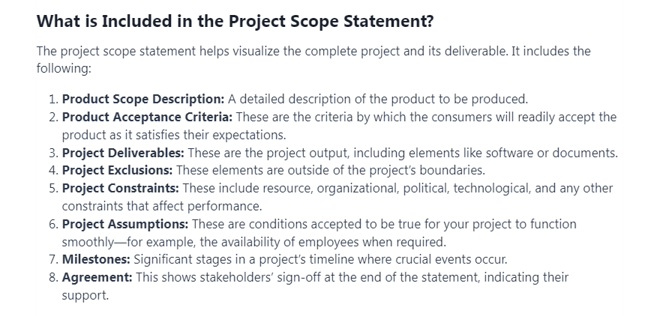
Introduction Chapter/Section

Slide 27
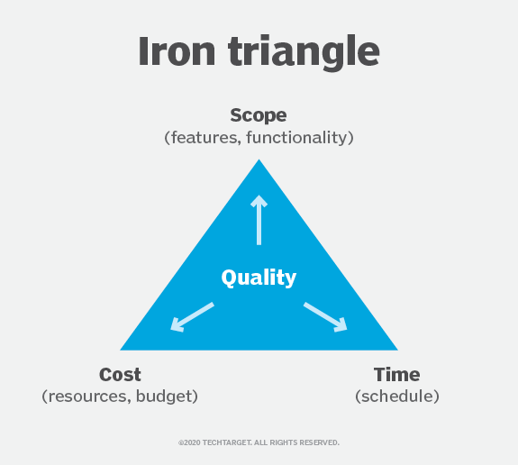
Project Constraints
Introduction Chapter/Section
Constraints in Projects

Slide 28
Constraints
Introduction Chapter/Section
A constraint in project management is any restriction that defines a project's limitations. For example, a project's scope is the limit of what the project is expected to accomplish.
The three most significant project planning and management constraints are time, cost and scope. They are sometimes known as the triple constraint or the project management triangle or the iron triangle.

Slide 29
Introduction Chapter/Section
Scope refers to the breadth and depth of features and functionalities incorporated into the software. It defines the boundaries of the project, outlining the project’s specific capabilities.
Cost represents the financial investment allocated to various aspects of software development, including initial development, necessary resources, and ongoing maintenance. Cost includes financial investments in not only the software itself but also labor, vendors, quality control, tools, etc.
Time dictates the deadlines for project delivery and establishes key milestones throughout the development process. This also includes the project’s schedule and the time at which each part of the project should be completed, including final delivery.

Slide 30
Who are stakeholders?
End User and Beneficiaries
Direct User
Secondary User
Beneficiaries-Customers and Vendors

Slide 31
Who are stakeholders?
Direct users
Those who will use the software directly are usually most concerned with how it will fit into their current workflows. They want to know that it solves a significant problem or otherwise makes their job easier.
Secondary users
Direct users interact with the software itself. Secondary users rely on the products of the software. New software needs to produce results in a format that fits into secondary users’ workflows. Forgetting about this group can cause one problem while solving another, like suddenly generating reports in a format secondary users can’t integrate into their analytics.
Beneficiaries
These are all the people affected by the software’s products. The term encompasses a huge base of customers and vendors who focus more on results than process. Their input should revolve around the services or information the software will provide.

Slide 32
Project definition
The project definition typically includes details such as
project goals,
requirements,
constraints,
stakeholders,
timeline, and
resources needed
It serves as a roadmap for project planning, execution, and evaluation, guiding the team throughout the project lifecycle.

Slide 33
Examples
This project created a dice game with unique features such as statistics tracking, accelerometer utilization for rolling, single and multiplayer support, sleek/simple user interface, and good look/feel.
This project developed a system that automates the process of checking for route validity between any two stations without the worry of having to understand the detailed rules of the ATOC Rail Routeing Guide.
This project designed, created, developed and evaluated the first step of the Virtual Doctor system.

